Slide 1

ALY 6980 Capstone Real Estate Agent Review Analysis
Professor – Valerie Atherley
Group 03
Mimansha Kaushik
Lichun Huang
Kritika Gehlot
Venkatesh Guri
Rutwiz Gullipalli
Date – 12/04/2024

Slide 2
The problem: mismatched expectations
Traditional Approach
Traditional agent matching methods rely heavily on personal networks and referrals, often failing to address individual preferences and specific agent expertise.
The Result ​
This lack of personalization leads to mismatched expectations and less-than-ideal experiences for buyers, resulting in frustration and dissatisfaction.

Slide 3
Methodology
Agent Data
Agent Review
Past Sales
Data Sources
NLP - Named Entity Recognition (NER)
NLP - Sentiment Analysis
NLP Techniques
Machine Learning Models
Random Forest Regression, Linear Regression, Gradient Boosting Machines
Classification Models, Support Vector Machines (SVM)
Recommendation
Front-End Development for Recommendation System

Slide 4
Data processing
Data Cleaning:
Date Standardization:
Data Merging:
Use loc_id as common key to merge past sales and agent review
Missing value: Ratings, property prices were imputed using the median to minimize bias
Extract State from address
Filter past sales record from 2010 to most recent date to match the time range in agent review dataset
Use name and location(state, pin code) to match agent information with agent review and past sales)

Slide 5
Data processing
Named entity recognition (NER):
Package: spacy
Extract agent name from reviews from agent review, use it as potential key to make agent name in agent data.
For reviews that may have multiple names, the most common name will be chosen as the identifier.
Sentiment analysis:
Package: textblob
Assess the polarity and subjectivity of customer reviews. A polarity greater than 0 will be categorized as positive feedback, while a polarity less than 0 will be considered negative feedback. This analysis can then be utilized to determine the percentage of positive comments for an agent in the subsequent step.

Slide 6
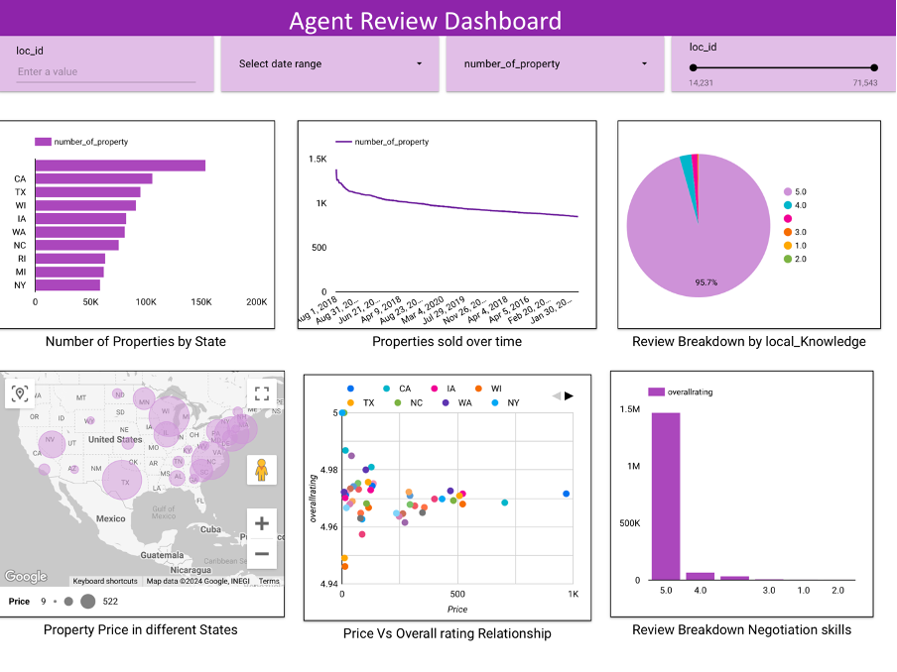
Looker dashboard

Slide 7
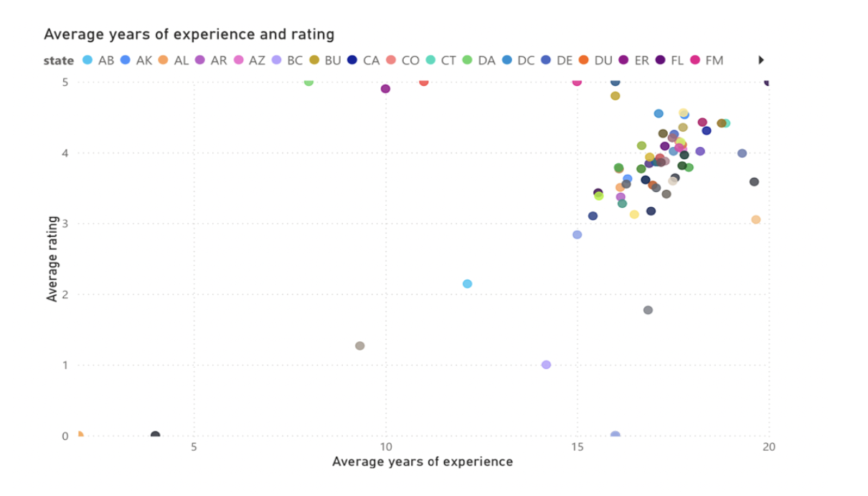
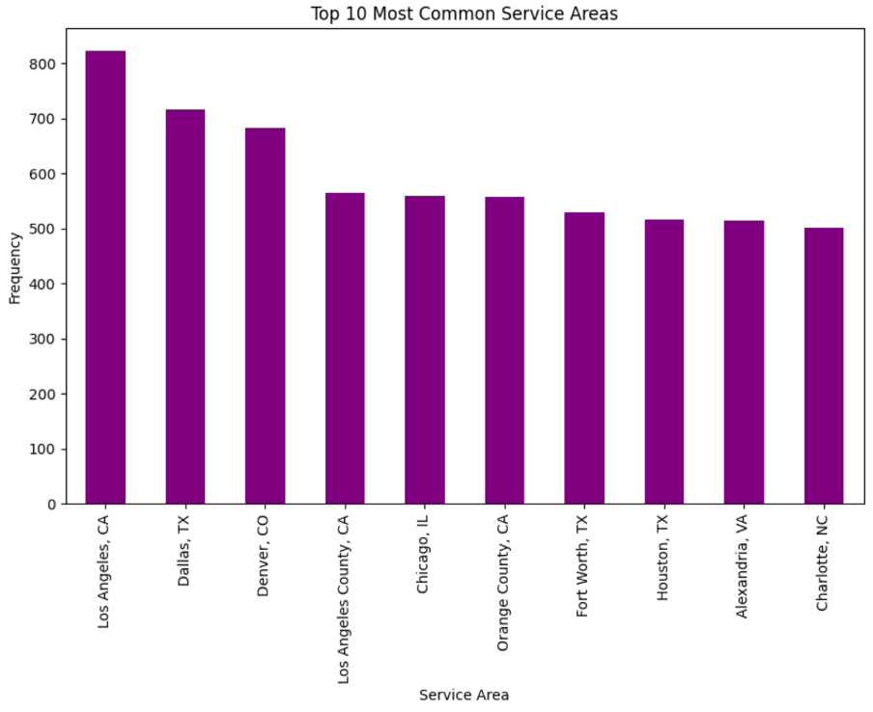
Exploratory data analysis (EDA)
Strong correlation between localized expertise and customer satisfaction, indicating that agents with deep knowledge of specific areas tend to receive higher ratings.​
Agents with more experience consistently receive higher ratings, suggesting a strong relationship between experience and positive customer feedback.​
Service areas with a high volume of transactions reflect regional demand, providing valuable insights into market trends and potential opportunities.​

Slide 8
Model Building
Main Goal: Recommend agents based on customer preferences and expertise.
Models:
Regression: Predict agent performance scores.
Classification: Categorize agents into performance tiers.
Linear Regression:
As a baseline model, Linear Regression exhibited limited explanatory power, with only 10% of variance explained.
The high MSE indicates difficulty in capturing non-linear relationships.
Random Forest Regression:
Enhanced performance compared to Linear Regression by accounting for non-linear interactions.
The modest R² reflects challenges in fully capturing the complexity of agent suitability prediction.
Gradient Boosting Machines (GBM):
GBM emerged as the top-performing regression model, leveraging iterative improvement to reduce error and enhance explanatory power.
The reduced MSE and higher R² reflect better model fit and predictive accuracy.
MSE: 3.5536
Random Forest Regression:
MSE: 3.0845
Gradient Boosting Machines (GBM):
MSE: 2.8273
Linear Regression:
R²: 0.1048
R²: 0.2230
R²: 0.2878

Slide 9
Model Building
Logistic Regression:
Accuracy: 80.65%
Support Vector Machines (SVM):
Accuracy: 84.64%
Logistic Regression Analysis:​
Simplistic yet effective, Logistic Regression achieved over 80% accuracy in binary classification (e.g., high vs. low suitability).​
Limited in capturing nuanced or multi-class suitability requirements.​
Support Vector Machines Analysis:
Outperformed Logistic Regression, with non-linear kernels effectively handling high-dimensional agent-customer data.
Delivered improved accuracy by capturing complex relationships.

Slide 10
Achieving Our Goals
How We Achieved It:
Engineered key features from profiles and reviews.
Applied regression and classification models.
Evaluated with R², MSE, and accuracy metrics.
Outcome:
Accurate, data-driven agent recommendations for Buyer Folio.

Slide 11
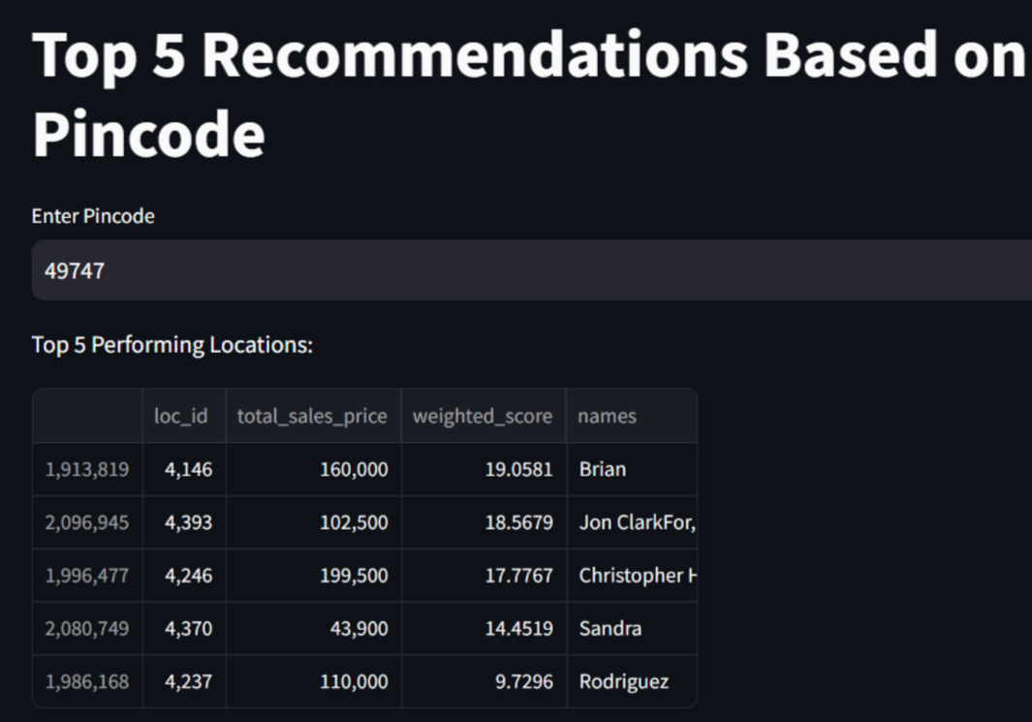
Recommender system development
Data Integration: Merged agent and property datasets based on agent names to link properties with corresponding agent information.
Name Matching: Applied substring matching to link agent names in property listings with the agent dataset, even when full merging was not possible.
Weighted Score Calculation: Properties are ranked based on a weighted score derived from agent ratings on attributes such as overall rating, local knowledge, and responsiveness.
Top Property Recommendations: Sorted and displayed the top 5 properties based on the weighted score, including agent details for informed decision-making.

Slide 12
Challenges and solutions
Employed robust data validation techniques to ensure data accuracy and consistency, leading to a more reliable and trustworthy recommendation system.
Data Integration Challenges
Overcame challenges in data integration and alignment techniques to ensure accurate and comprehensive analysis.
Data Accuracy and Consistency

Slide 13

Key takeaways
This project has delivered a powerful data-driven solution that addresses the challenge of matching buyers with the most suitable agents. The system has achieved high accuracy and reduced error rates, ensuring personalized and effective recommendations for clients. This underscores the transformative potential of AI in the real estate industry and beyond.

Slide 14
References
Yadav, Dinesh. “Categorical Encoding Using Label-Encoding and One-Hot-Encoder.” Medium, Towards Data Science, 9 Dec. 2019, towardsdatascience.com/categorical-encoding-using-label-encoding-and-one-hot-encoder-911ef77fb5bd.
Smith, J. A., & Doe, R. L. (2023). Machine learning applications in real estate recommendations. Journal of Real Estate Analytics, 15(3), 213-228.
Mostafa, M. M. (2013). More than words: Social networks' text mining for consumer brand sentiments. Expert Systems with Applications, 40(10), 4241-4251.
Levitt, S. D., & Syverson, C. (2008). Market distortions when agents are better informed: The value of information in real estate transactions. Review of Economics and Statistics, 90(4), 599-611.

Slide 15
Thank You!

